Slide 1
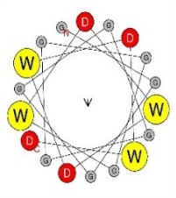
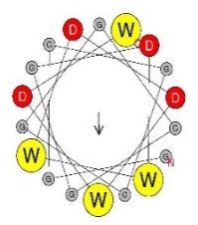
Fig. 1
A
Experimental setup
B
C
D
E
F
G
GGGGGGGGGGGGWDWDWDWD -1.13
GGGGGGGGGGGGDWWDDWDW 1.11
Figure 1. Single W and single D is sufficient for functionality of AD. A – experimental setup: oligo pool synthesis, cloning in bacteria, transformation in yeast, screening for growth phenotype, isolation of pool DNA, NGS sequencing, data analysis. B – X axis: individual sequences indicated in the inset table, where black dots represent glycine, yellow dots represent tryptophan, and red dots represent aspartic acid residues, Y axis: Log2 growth slope. C, D, E, F – same as B representing alternative sequences. . E – sequence tables are simplified to show only 1 W & D and 5 W & D. Sequences with 2 W & D, 3 W & D, and 4 W & D fitting the same pattern of 0 to 9 glycines inserted between aromatic and acidic patches are represented in plot below. F – Error bars show growth slope +/- root-mean-square-deviation (RMSD) of the fit of the growth slope. . G – indicated sequences with Log2 growth slope and images of the α-helix frontal view for corresponding sequence.

Slide 2
Fig. 2
A
B
W = 6 D = 6
D
● - [DE]
● - [WYF]
●●●●
●●●●
●●●●
●●●●
●●●●
C
●●●●
●●●●
Motif
●●●●
WYF = 6 DE = 6
●●●●
●●●●
●●●●
●●●●
●●●●
●●●●
●●●●
●●●●
E
F
Functional tAD %
G
Functional tAD %
ML Features | ROC AUC
aa composition | 0.61
aa x position | 0.72
tetrapep | 0.78
tetrapep x position | 0.82
tetrapep x position (trained on Gcn4) | 0.67
tetrapep x position + balance | 0.87
Shallow NNet | 0.90
● - [DE]
● - [WYF]
●●●●
●●●●
●●●●
●●●●
●●●●
●●●●
●●●●
●●●●
●●●●
●●●●
●●●●
●●●●
●●●●
●●●●
●●●●
●●●●
Figure 2. Balance and intermixing of acidic and aromatic residues is beneficial for function. A – X axis: balance score calculated using formula N=NW-nD, Y axis: % of functional sequences in the pool of sequences containing all combinations of W and D for 12 positions (WD12 library 3968 sequences total). B – X axis: mixing score calculated using formula N =n(WD)+n(DW), Y axis: % of functional sequences in the pool of sequences containing all combinations of 6 W and 6 D (906 sequences total). C – X axis: mixing score calculated using formula N=n( [WYF][DE] ) + n( [DE][WYF] ), Y axis: % of functional sequences in the pool of sequences from Gcn4 random peptide library with 6 [WYF] and 6 [DE] (3018 sequences total). D – X axis: % functionality of sequences that contain the specified tetrapeptide motif, Y axis: tetrapeptide motifs. Regression lines are provided to demonstrate concordance between the three libraries. E – X axis: Starting amino acid position of tetrapeptide in tAD module for the WD12 library, Y axis: 16 sequence combinations for tetra-peptides containing D and W, Tile fill: % functionality of sequences that contain the specified tetrapeptide motif at a certain position. F – X axis: Starting amino acid position of tetrapeptide in tAD module for Gcn4 library, Y axis: 16 sequence combinations for tetra-peptides containing [DE] and [WYF], Tile fill: % functionality of sequences that contain the specified tetrapeptide motif at a certain position. G – ML accuracy of Ridge models trained on functional vs non-functional for 80% of WD12 library and tested on held out set of 20% WD12 library, measured with ROC AUC.

Slide 3
Fig. 3
A
B
C
Gal4 C-terminus
Gcn4 C-terminus
End caps
*
End caps
**
D
E
Sequence Constructs
. = G (Gly) x = W or D
● = D (Asp) ● = W (Trp)
***
*
........xxxxxxx●●●●●
***
..........●●●●●●●●●●
****
..........●●●●●●●●●●
. = Any amino acid ϕ = [AVILMWYF] ● = [WYF]
****
**
........................ϕϕϕ●●●
Figure 3. Ds are generally beneficial internally, while Ws – terminally; however with increased amount of clustered Ws in the sequence, flanking them with Ds rescues the functionality. A – X axis: position of D (red line) or W (yellow line) within the sequence, Y axis: % functionality of sequences in the pool of sequences containing all combinations of W and D for 12 positions (3968 sequences total). B – Y axis same as in A, X axis: size of W cluster preceding indicated end cap for sequences representing each line. C – same as B calculated for Gcn4 library using [WYF] instead of just W and [DE] instead of just D. D - sequences with indicated growth slopes. Red dots represent D and yellow dots represent W. E – visualization of sequences used in other panels marked by star objects.. AlphaFold2 predicted structure displayed above sequence for (***) and (****) sequences.

Slide 4
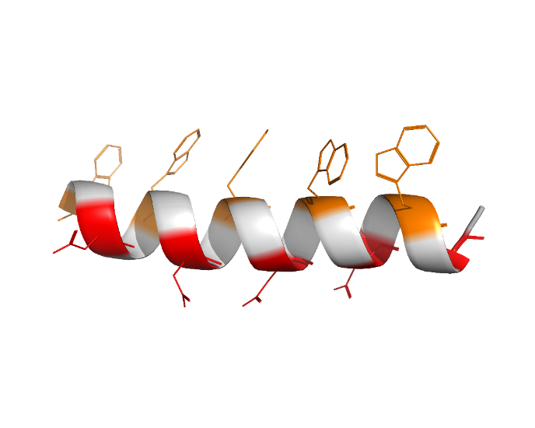
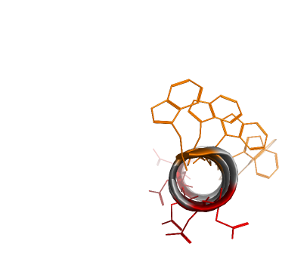
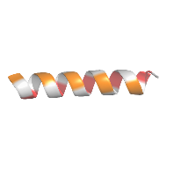
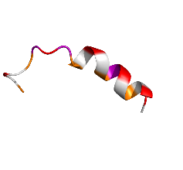
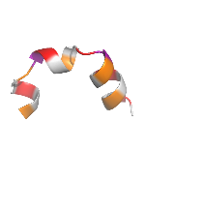
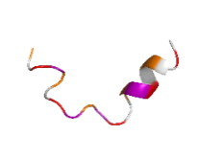
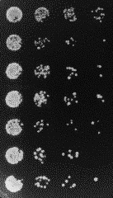
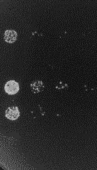
Fig. 4
A
B
Amphipathic Backbone Library
[W.D.W.D.W.D.W.D.W.D.]
Side view
Top view
C
D
WLDFWLDTWVDTWLDFWLDI
-1.74
WGDLWPDPWYDWWPDLWRDL 1.60
0-P
3-P
WFDLWPDLWTDPWIDCWLDV
1.51
WEDPWADPWPDGWPDLWADV
1.14
2-P
4-P
E
No Aur
+Aur
Stop codon
GGGGDFDLDMLGDFDLDMLG
DDDDDDDDDDWWWWWWWWWW
DWDWDWDWDWDWDWDWDWDW
WEDPWADPWPDGWPDLWADV
WNDYWTDSWADYWYDFWYDV
WFDSWDDFWCDCWCDCWSDF
Figure 4. Formation of the amphipathic α-helix is generally detrimental for AD functionality, while insertion of proline in the sequence is beneficial. A – graphical representation of sequences for the WD5 library (107975 sequences), each member of which has five Ws, five Ds, and ten random amino acids represented by black dots/circles between Ws and Ds. B – Y axis: % functionality of sequences in the WD5 library. X axis: % of α-helix predicted by SPOT-1D algorithm for each set of sequences from WD5 library. C – Y axis: % functionality of sequences. X axis: count of corresponding amino acid residues between set Ws and Ds of WD5 library. D – 3D structures of sequences with varying number of proline residues predicted by AlphaFold2. E – growth phenotype on the media with and without aureobasidin for cells expressing indicated sequences. Spots are conglomerates of yeast colonies representing three-fold serial dilutions of corresponding cell cultures.

